Slide 1
CHINOOK
MUSIC
STORE
PROJECT
Created By
Badam Sai Abhigna
20-07-2025

Slide 2
Introduction and Objectives
Chinook Music store is a leading provider of mmsic records with a diverse range of genres and albums.
Chinook is committed to customer satisfaction .
This project explores a
Data of Chinook music store
The main objective is to analyze music record sales data to gain insights and make recommendations for the company's strategy in the physical music market.

Slide 3
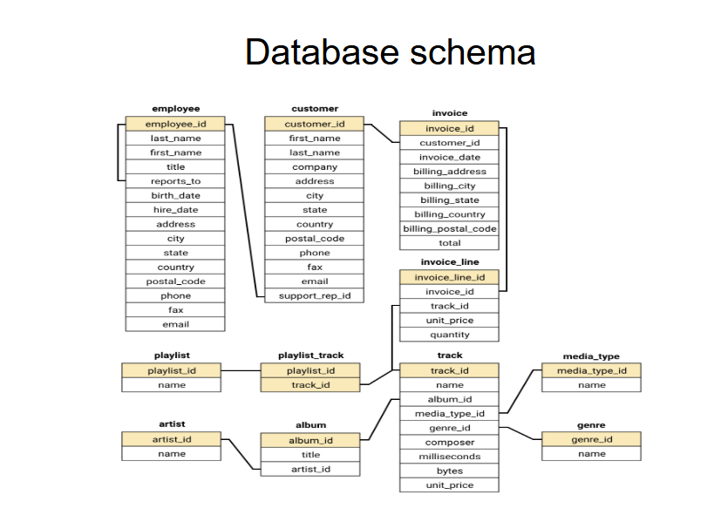
Database Schema

Slide 4

Data Overview
About Data
There are total of 11 tables :
customer, employee, invoice, invoice_line, genre,
track, artist, album, media_type, playlist and playlist_track
Data cleaning and Preprocessing
No Duplicate Values.
Missing Values :- There are some missing values in customer, employee and track tables . They are handled
No data formatting is done
Key Data Points
Some of key entities are in customer, invoice, invoice_line, track, genre ,album and artist tables.
There are total of 24 countries
Data Importance
This data consists of customers info in different countries states and cities this will help the data store for recommendations and strategies
It helps for genres, album, artists recommendations for store growth
Assumptions
The units of price is not given anywhere.
So I just state them as units

Slide 5


Methodology
01
Data Understanding :-
Did some review of the provided data sets to understand which tables are most important for our analysis.
02
Data Cleaning :- Null values are identified using IS NULL operator and they are handled and duplicate values are checked on basis of primary key
Descriptive Analysis :-
For each task ,queries are run in MySQL using GROUP BY, ORDER BY, JOINS,SUB QUERIES, CTEs and some functions are used in different queries text function like CONCAT, date function like DATEDIFF,DATE_SUB, TIMESTAMP DIFF
03
04
Interpret the results :-
Based on output of these tasks queries insights are taken and suggestions are made.
05
Visualizations :-
In some case using excel some charts are made

Slide 6
No of Customers and Revenue and No of invoices per country
USA is top in no of customers 13 , more no of invoices 151 and also in revenue generated 1040.49 units
Followed by Canada and Brazil.
France and Germany are in moderate level of customers(4-5) ,revenue(300-400) and invoices(60-80)
Remaining countries has relatively less numbers of customers and revenue

Slide 7
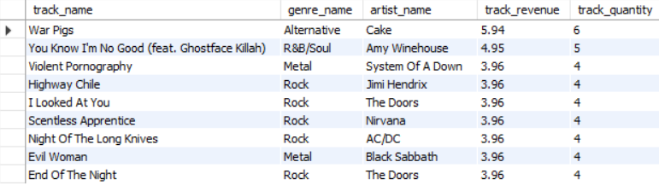
Top 9 tracks in USA based on revenue
The top selling track in USA is “War Pigs” with revenue and its genre is Alternative.
The most famous genre of top selling tracks is Rock and around 5 out of 9 are in rock genre.
As we can see the revenue difference between top selling tracks is not that big so we can say the tracks related to Rock genre contribute a lot of revenue.

Slide 8
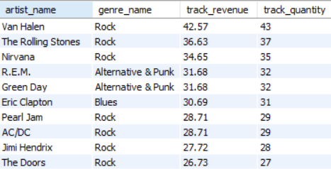
Top 10 artists in USA based on revenue
The top artist in USA is Van Halen with a revenue of 42.57 units and his tracks belongs to Rock genre followed by The rolling stones with a revenue of 36.63 units and Nirvana with revenue of 34.65 units and also these two belongs to the rock genre.
Almost 7 of 10 top artist produce tracks related to Rock genre
From this we can say the Top genre is USA is “Rock”

Slide 9
Genre vs Revenue Generated in USA
Almost half the revenue generated by the Rock genre.
Followed by Alternative & Punk 12% and Metal 11%.
Together all this three genre covers almost80% of revenue.

Slide 10
Genre vs no of countries which has the genre as their top 3 other than USA
All the countries has Rock genre as one of their top 3 genre following .
20 countries has Alternative & Punk and 18 countries has Metal.
Most no of countries follow similar pattern as USA

Slide 11
Customer Purchasing Behavior
From the chart, we can see that František has the highest purchase count, with a total of 18.
And next top frequency is 16 and 15
Almost all customers falls in frequency of 8-13
Daan and Robert has least.

Slide 12
Customer Purchasing Behavior
Average order value of customer varies from 400 to 182.
John Gordon has highest average order values .
Most of the customer has average order value around 250-350.

Slide 13

Some more key insights
All the customers have purchased tracks of at least three genres.
Around 80% customer doesn’t made any order in last 6 months.
Genre Affinity : Metal and Rock, along with Alternative & Punk and Rock, are often purchased together, indicating shared fan bases.
Artist Affinity : Green Day and Led Zeppelin, as well as Nirvana and The Rolling Stones, are often bought together, showing cross-genre appeal.
Album Affinity :Mezmerize is often paired with classic rock albums like "Are You Experienced?" and "The Police Greatest Hits," showing broad appeal.
Countries like Czech Republic, Ireland, Spain, Chile have a high average total spent and average track purchased per customer
Argentina, Denmark and Italy have a low average total spent and average track purchased per customer
USA, Canada and France are in top 3 in customer count and revenue but their average spent per order and average track purchased by customers is moderate
Every customer’s actual revenue is greater than their predicted revenue.

Slide 14
Conclusion
Our analysis of music store has revealed significant opportunities for gain insights and make recommendations for the company's strategy in the physical music market.
By analyzing location, genre ,album, artist with revenue gave the insights about what need to be improved where
This data-driven strategy allows us to make informed decisions that enhance our chances of success, ensuring effective global presence.

Slide 15


References
Data Provided by Team.
Software Used :-
MySQL
MS Excel
MS Word
MS PowerPoint

Slide 16
Thank You!

